Slide 1

Poster Formatting Guidelines
2026 Master Brewers Conference
Goal: presenting the main findings of your work in a concise and easy-to-follow way!
Poster dimensions: 36 inches wide x 48 inches tall (vertical orientation)
Font size recommendations:
  Takeaway (main poster header): 75 - 90 pt
  Formal title: 40 - 50 pt
  Main body: minimum 28 pt
  Author names and affiliations: 40-50 pt
Font tips
  Use a sans serif font such as Arial or Helvetica for readability
  Use a consistent font throughout with bold text for headings and emphasizing key points
Sections
  The purpose of each section is explained in the template
  The fewer words the better! Focus on using high quality visuals with brief descriptions
Visuals
  Keep raw data to a minimum, instead tell a story with graphs, charts, or diagrams
  Use high resolution images. Download and insert the highest resolution possible. Screenshots often are too pixelated.
QR code
  Link to your paper, contact info, or any relevant supplementary information
  Generate a QR code with this website or similar: https://www.qr-code-generator.com/
  Tip: test your QR code before printing your poster!

Slide 2


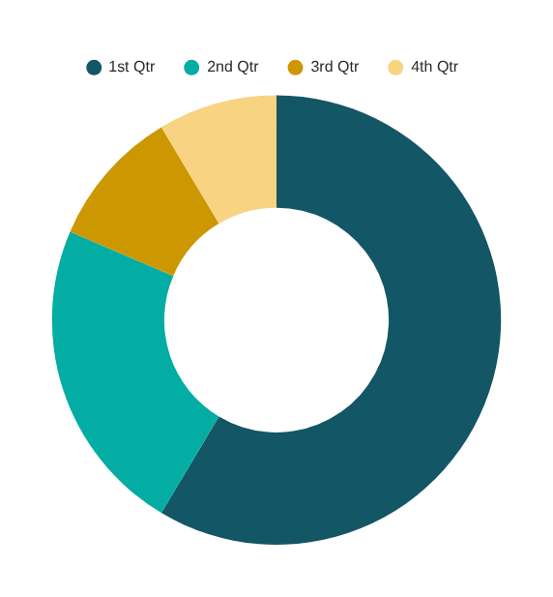
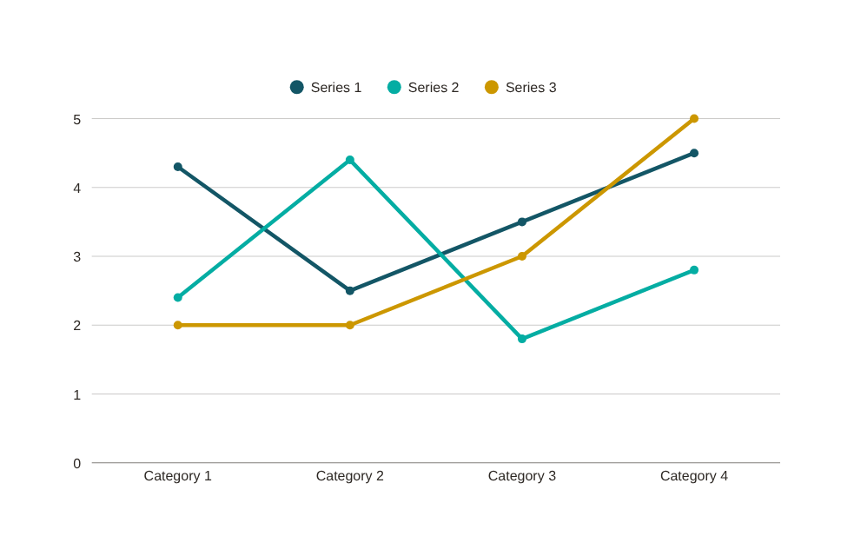
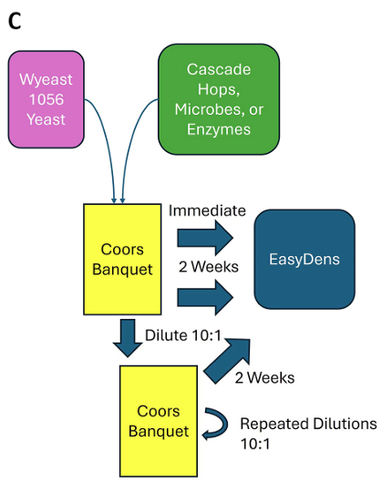
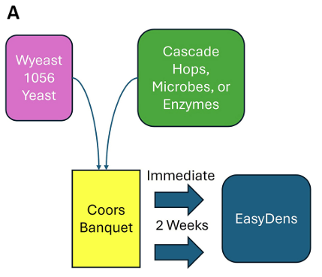
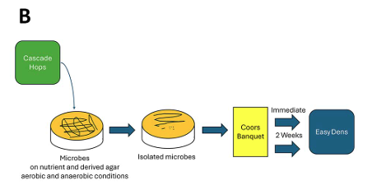


Teach people the cool thing you learned in 5 seconds
(takeaway, not title)
Title Goes Here: Extra Space for Long Titles
Background Information: This section should be about the problem, project justification, and/or the hypothesis. It should be short and sweet to tell attendees why the research is important.
The fewer words the better! Focus on using high quality visuals with brief descriptions.
Section 1 (ex: Result 1): Quickly explain what the graph shows. Help people think.
Section 2 (ex: Result 2): Big figures are easier to skim at a distance, and more accessible.
v
v
Example - Example
You can create charts in PPT like these examples
Example - Example
Section 3 (ex: Methods): Use an infographic or photos to demonstrate methods rather than using text. BioRender.com, TheNounProject.com, Canva.com, Visme.com, and PowerPoint are just a few free tools for making infographics.
Example - Example
Example - Example
Example - Example
Closing Section: Use this space to include additional information such as limitations, acknowledgements, future planned work, another key takeaway, actionable item(s) for brewers, etc.
Copy & Paste Your QR Code Into The White Box
Author Name(s) and Affiliations (logos allowed)

